Slide 1

Divvy Analysis
Casual riders Annual members
Arunakchutha
9-Dec-22

Slide 2

Objectives
Data trivia
Source
Data health
Monthly data from the first-party source ensures that the data is reliable and original.
Understand how casual riders and annual members use the bikes differently.
100%
Period covered
13 months
August 2021 – September 2022
How to use digital marketing to improve the conversion rate from casual to annual members?
Anomalies
Licenses
Data errors and anomalies have been fixed and the data is clean.
Licensing, privacy, and security concerns have been addressed appropriately.

Slide 3
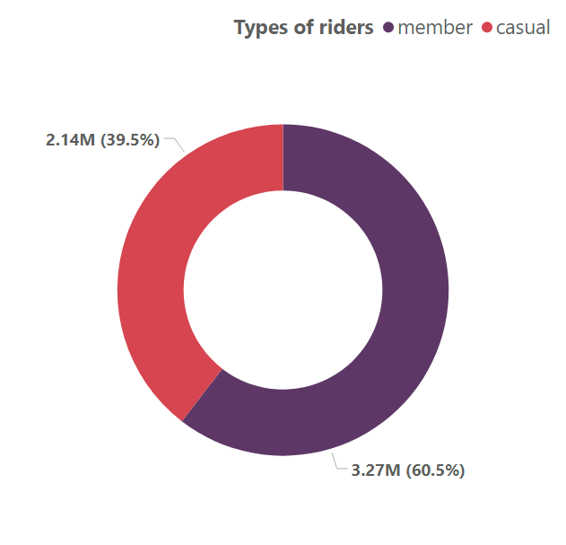
Differences between the two riders w.r.t number of rides
The number of rides taken by the annual members (3,270,311) was higher than casual riders (2,139,489).
Annual members accounted for 60.45% of the number of rides completed in 13 months.

Slide 4
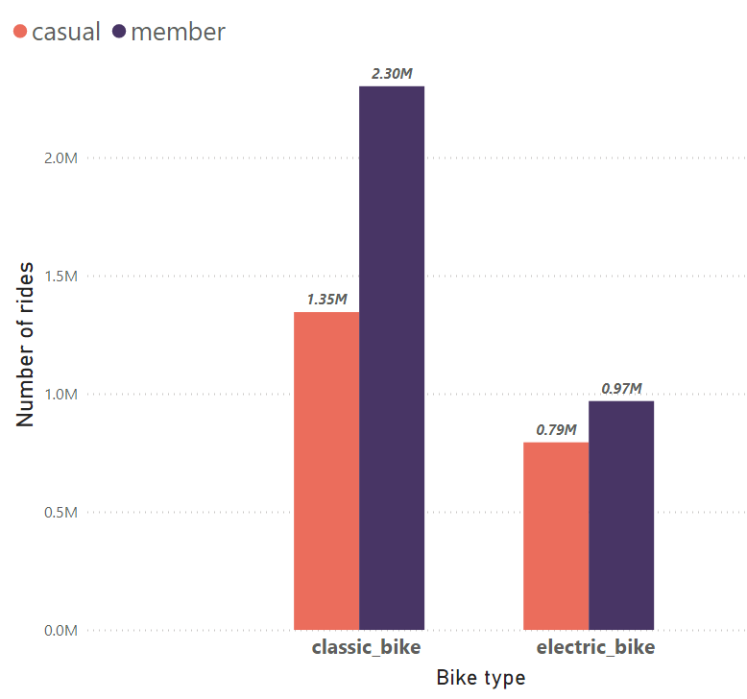
Differences between the two riders w.r.t Bike type
The total number of rides was higher for members(32,70,311) than for casuals(21,29,489).
54%
The number of rides for member and casual riders diverged the most when the bike type was the classic bike, where the number of member rides was 956,208 higher than casual.
70%
The use of classic bikes among casual riders made up 42.54% of the total number of rides.
42%

Slide 5
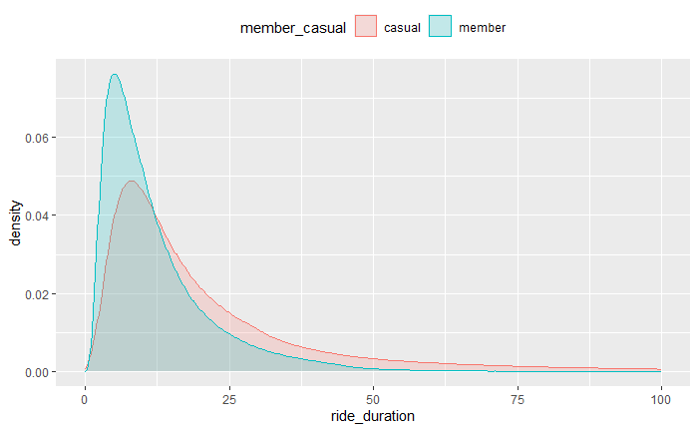
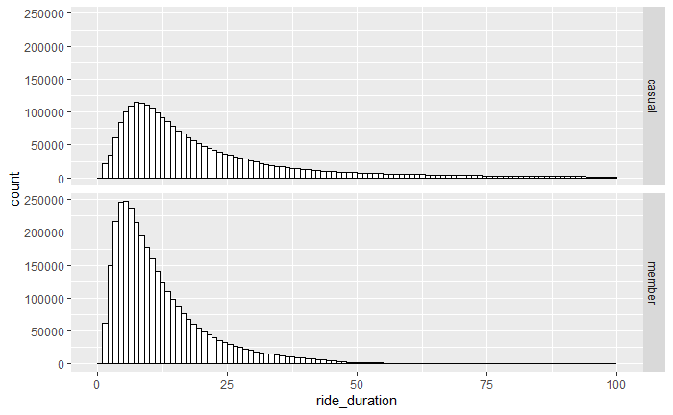
Differences between the two riders w.r.t Ride Duration
The number of annual member rides that have a ride duration closer to the median ride duration is two times more in number when compared with the casual riders.

Slide 6
Descriptive Statistics w.r.t Ride Duration
Min ride duration
Median ride duration
Mean ride duration
Max ride duration
Casual Riders
1.00 mins
14.9 mins
25.2 mins
23 hrs. 59 mins
Member riders
1.00 mins
9.4 mins
12.86 mins
23 hrs. 55 mins
Median ride duration differs significantly between the two types of riders: 15 mins for casual riders to 9.4 mins for member riders.
The casual members have more variation in ride duration whereas the members have a more predictable ride duration of around 9.4 mins.

Slide 7
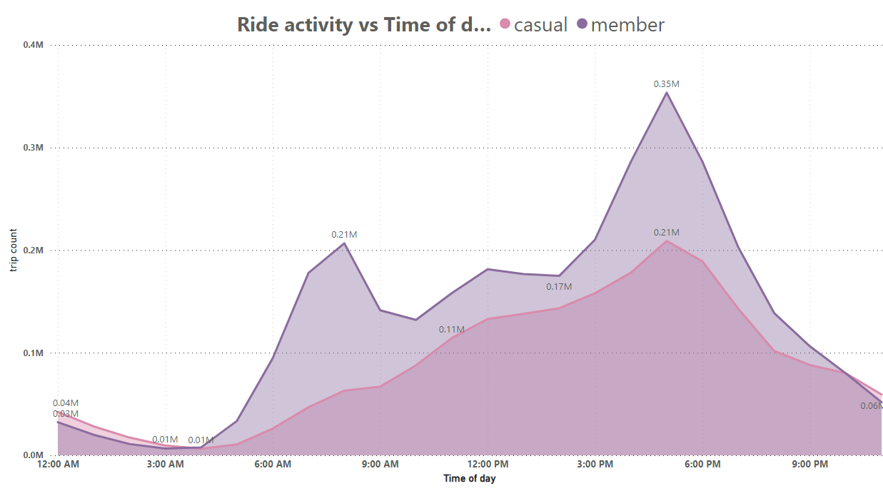
Differences between the two riders w.r.t Time of day
Ride hours for members indicate trips to and from work or school:
7:00 am – 9:00 am
12:00 pm – 1:00 pm
4:00 pm – 7:00 pm
Rides hours of casual riders indicate a linear increase throughout the day with peaks at 5:00 pm and declining thereafter.

Slide 8
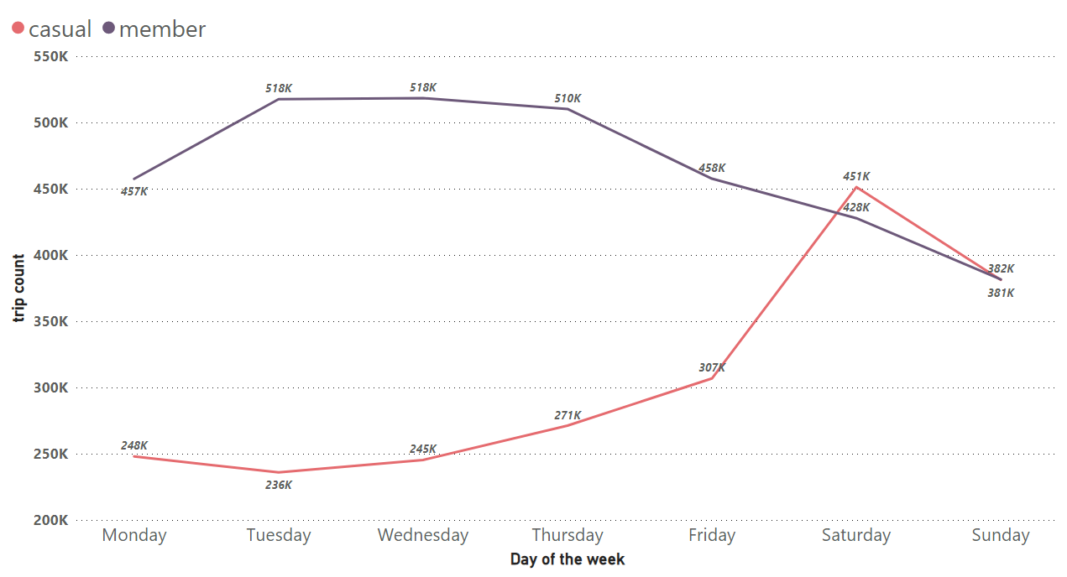
Differences between the two riders w.r.t Day of the week
Weekend rides contributed to 38.6% of total rides taken by casual riders.
39%
Weekend rides contributed to only 24.7% of total rides taken by the annual members.
25%
Weekday rides contributed to 61% of the total rides taken by casual riders.
61%
Ride activity for casual riders is much lesser than for annual members on weekdays.
Whereas annual members do most of their trips on weekdays.
There is no notable difference on weekends between the two types of riders.
Weekday rides contributed 75% of the total rides taken by the annual members.
75%

Slide 9
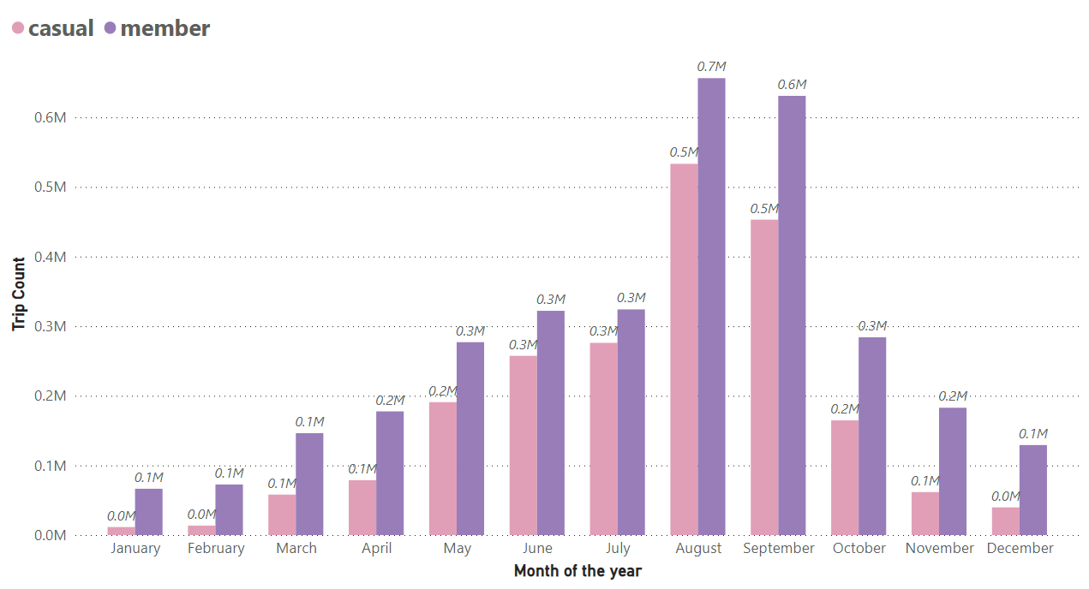
Differences between the two riders w.r.t Month of the year
Ride activity for both casual riders and members follows a similar distribution with one notable difference being, in winter months, the number of casual member rides had significantly diminished when compared to annual members.

Slide 10
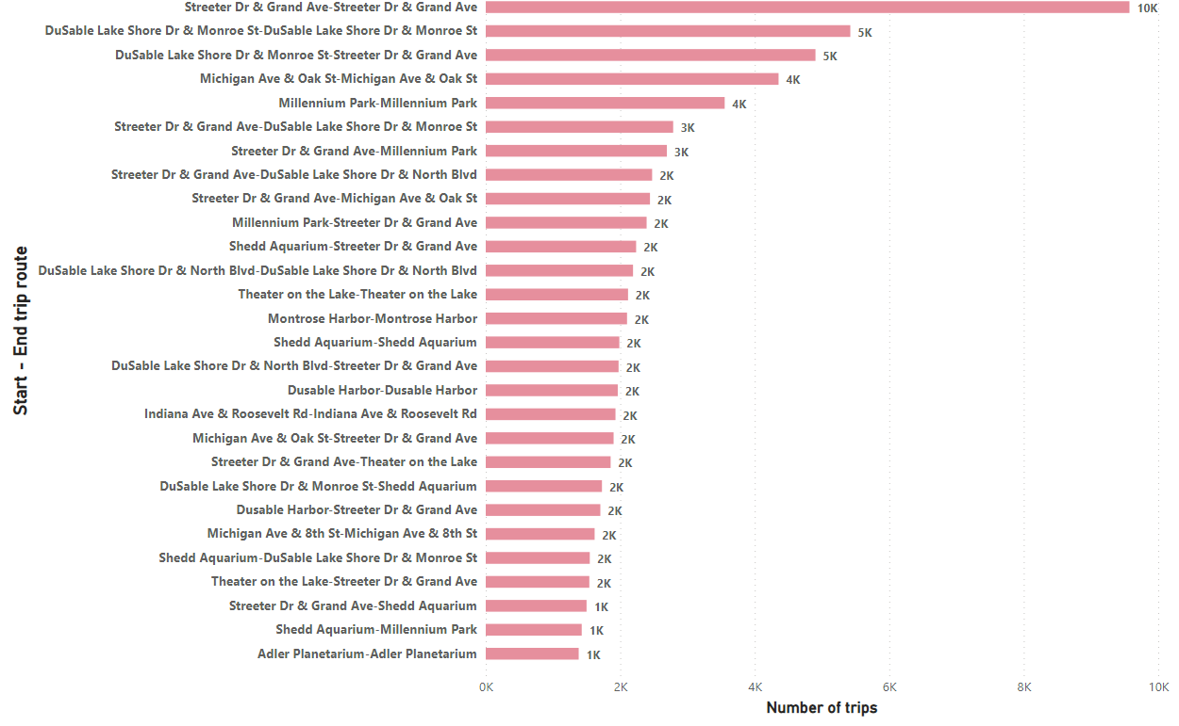
25 most frequented trip routes for casual riders

Slide 11
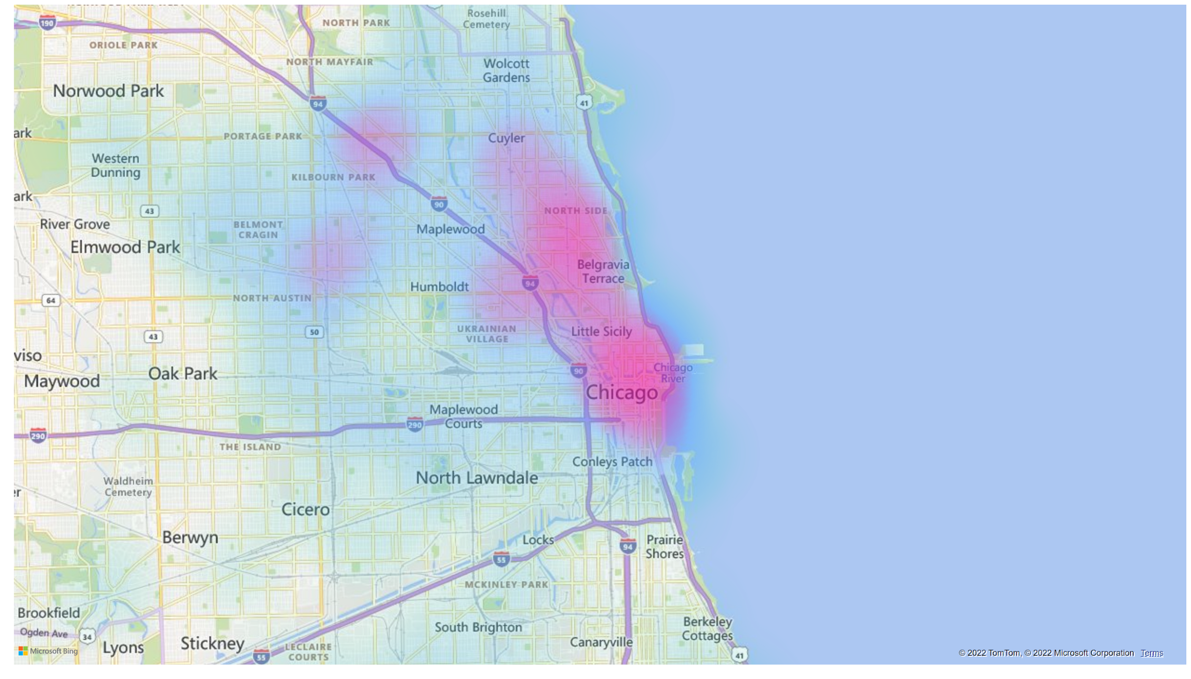
Heatmap visualizing the activity of casual riders
August 2021 – September 2022
Notes:
map
No alt text provided

Slide 12
ANNUAL MEMBERS
CASUAL RIDERS
10%
20%
30%
40%
50%
60%
70%
80%
90%
100%
Introducing new joiners offers for casual riders focusing on ride duration of 9 mins – 25 mins for a pre-determined number of classic bike rides. Reasoning: Classic bikes are popular among classic riders and historic data suggests classic ride durations are spread out more.
Incentivize riders on weekends using targeted marketing campaigns as there is more casual rider activity on weekends.
Introducing membership exclusive reward point system which gives more rewards (1X, 2X, 3X ) when starting rides from the stations that are popular among casual riders, thereby encouraging more casual members to have the incentive to become a member.
Marketing ads like billboards or signboards can be placed in and around places, stations, and routes that are frequented by casual riders.
Introducing new joiners coupons for casual riders targeting the rides happening from 3:00 pm to 7:00 pm.

Slide 13
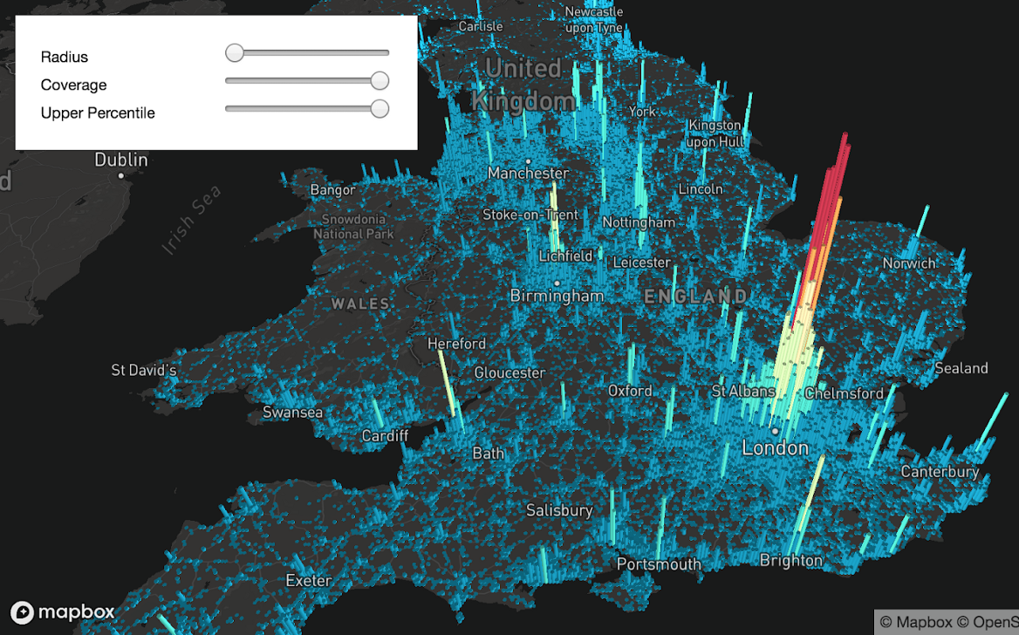
Future analysis roadmap
MapBox
Heatmaps
A live heatmap using the paid MapBox API that visualizes in 3D, the ride activities over the entire Chicago area. This facilitates on-the-fly visualizations for any desired parameter changes.

Slide 14
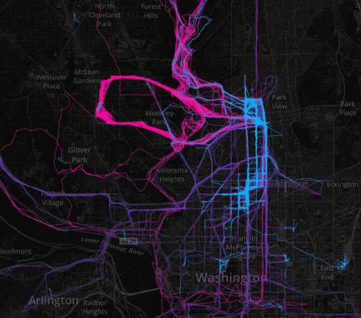
Future analysis roadmap
Google Maps Api + User’s GPS data
With GPS data of the rides, further analysis could shed insight into:
The most popular routes instead of just start point and end point.
Traffic by Time of Day.
Traffic by Location.

Slide 15
Future analysis roadmap
With access to financial data, the results of such analysis could provide more insights and strategies for the long term. Possibilities include but are not limited to :
A pricing analysis to understand the most profitable ride types
The average spending of casual members and its correlation with pricing and offers.
The expenses in regards to maintenance of bikes and especially how the electric bikes differ from classic bikes and what can be done to optimize that.
Analyze the spending patterns to identify if members are comfortable with weekly or monthly or annual passes.
An in-depth analysis of ride cancellation data.

Slide 16
Thank you !

